Slide 1


LOGISTICS OPERATIONS & FLEET PERFORMANCE ANALYTICS
A Power BI Business Intelligence Project
PRESENTED BY : MILA JOSEPH

Slide 2

Introduction & Objectives
Project Overview
A Power BI project analysing logistics operations and fleet performance using data from 2022–2024.
Business Problem
Logistics operations involve multiple activities, including shipments, routes, customers, drivers, fuel purchases, maintenance and deliveries.
When this information is stored across different records, it becomes difficult to get a complete picture of business performance, identify operational issues and understand costs.
Objectives
  Analyse revenue and shipment trends.
  Compare route and customer performance.
  Monitor fuel and maintenance costs.
  Evaluate delivery performance and driver operations.

Slide 3
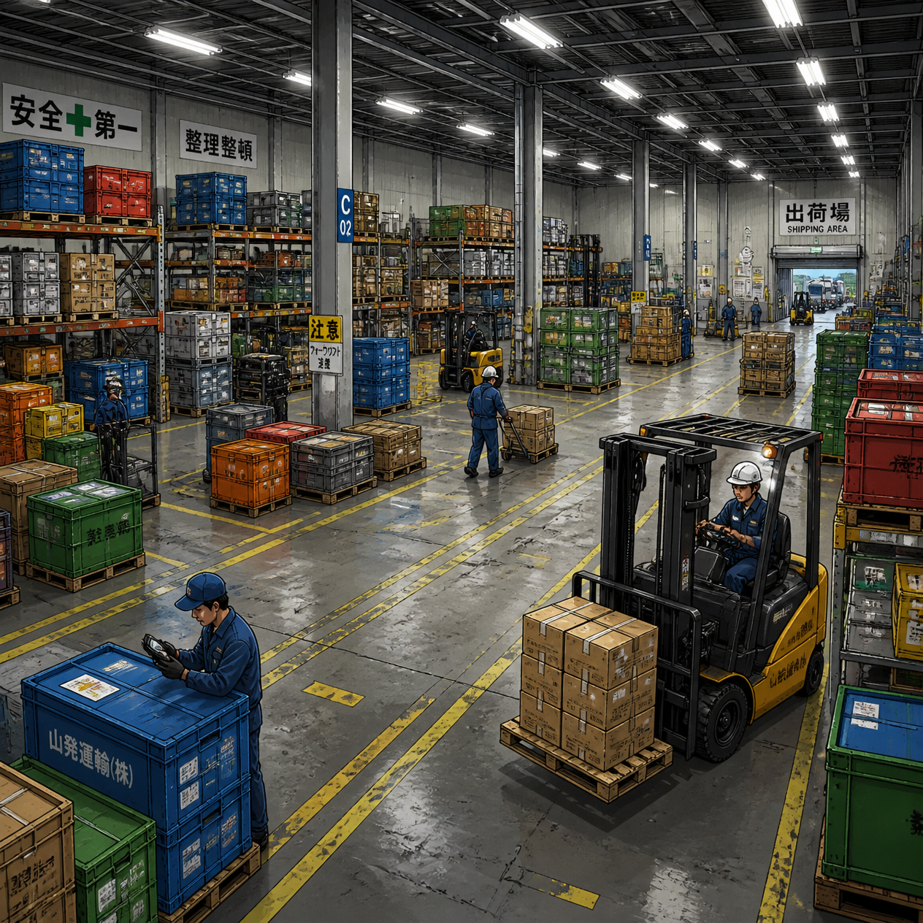
DATASET OVERVIEW
Data Source
Kaggle — Logistics Operations Database (2022–2024)
Dataset Description
A synthetic dataset representing the operations of a trucking company.
Data Structure
  14 interconnected tables in the original dataset.
  More than 85,000 load records.
Important Data Fields
  Loads and trips
  Customers and routes
  Drivers and trucks
  Fuel purchases
  Delivery events
  Maintenance records
  Table Selection
  9 relevant tables selected from the original 14 for analysis.

Slide 4
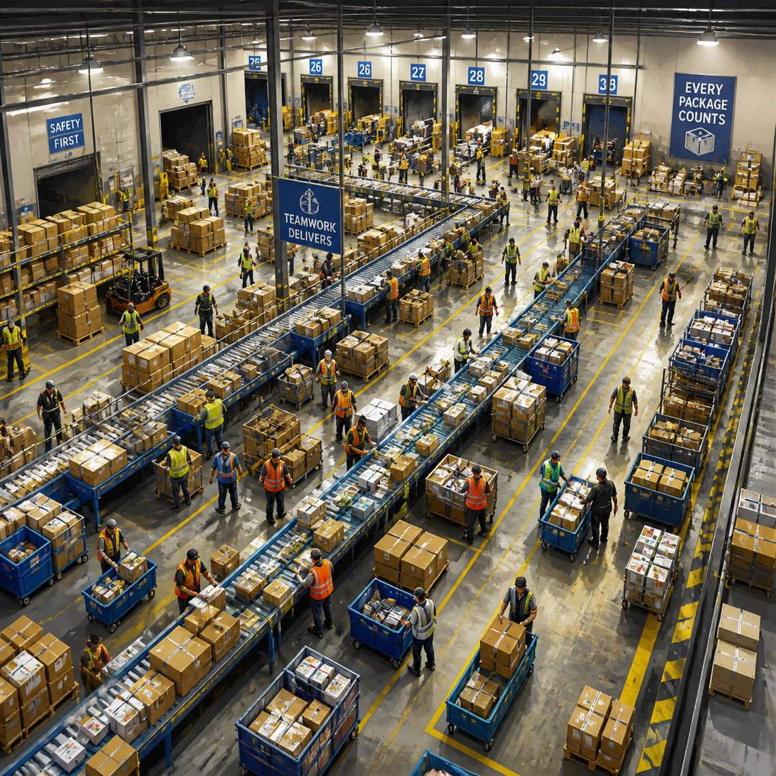
DATA CLEANING & TRANSFORMATION
Data Preparation
  Evaluated all 14 source tables and selected 9 relevant tables based on project objectives and data relevance.
  Imported the selected CSV tables into Power BI.
  Reviewed column names, data types and table structures.
  Merged Fact_Loads and Fact_Trips using Power Query to create Fact_Load_Trips.
  Created a calculated Dim_Date table to support year-wise and time-based analysis.
Data Quality Checks
  Checked for missing values, duplicate records and data errors.
  Verified key columns and IDs used to connect tables.
  Preserved missing driver and truck IDs rather than assigning artificial values.
  Checked data consistency across the selected tables.

Slide 5
DATA MODELLING
Model Structure
Designed a Galaxy Schema (Fact Constellation Schema).
9 tables: 4 Fact Tables + 5 Dimension Tables.
Combined Fact_Loads and Fact_Trips into Fact_Load_Trips.
Relationships
  Connected tables using matching ID columns.
  Used one-to-many relationships where applicable.
  Used single-direction filtering for the main relationships.
Fact Tables
Fact_Load_Trips — Load, trip, revenue and distance details.
Fact_FuelPurchases — Fuel transactions and expenditure.
delivery_events — Delivery events and delivery status.
Fact_Maintenance — Maintenance costs and downtime.
Dimension Tables
Dim_Date — Year, month, quarter and date attributes.
Dim_Customer — Customer details.
Dim_Route — Route information.
Dim_Drivers — Driver details.
Dim_Trucks — Truck details.

Slide 6
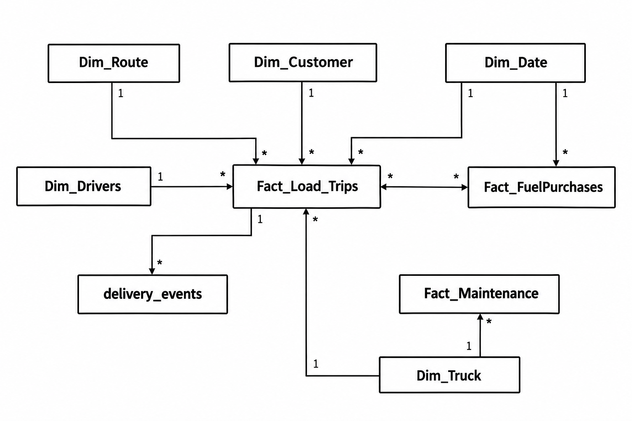
DATA MODEL

Slide 7
DAX MEASURES & CALCULATIONS
Key Measures
  Total Revenue : Calculates total revenue.
  Total Loads : Counts unique loads.
  Total Distance : Calculates the total distance travelled.
  Revenue per Mile : Calculates revenue generated per mile.
  On-Time Delivery Rate : Calculates the percentage of on-time deliveries.
  Total Fuel Cost : Calculates total fuel purchase cost.
  Total Maintenance Cost : Calculates total maintenance cost.
Advanced DAX
  Used CALCULATE to apply filter conditions.
  Used RANKX to rank routes.
  Used SELECTEDVALUE for dynamic Top/Bottom analysis.

Slide 8
REPORT DESIGN & VISUALIZATIONS
Page 1: Executive Overview
  Overall business performance through revenue, loads, distance, delivery rate and operating costs.
  Monthly trends in revenue and loads, with fuel and maintenance expenditure comparison.
Page 2: Revenue, Routes & Customer Performance
  Analysis of route revenue, customer contributions and highest/lowest performing routes.
Page 3: Fleet, Drivers & Operations
  Driver performance, fleet maintenance costs and resource analysis.
  Delivery performance analysis, including late delivery investigation.
PAGE 4: ROUTE DETAILS
- Route-specific performance analysis using Drill-through.
Design
  Consistent navy, blue, white, and orange colour theme.
  KPI cards, suitable charts and interactive visualisations.

Slide 9

POWER BI FEATURES & INTERACTIVITY
  Year and Load Type slicers
  Bookmark-based filter panel
  Dynamic Top/Bottom route ranking
  Decomposition Tree for late-delivery analysis
KEY ANALYSIS & BUSINESS INSIGHTS
Operating Costs: Analysed fuel purchase and maintenance costs.
Revenue: $262.53M across all years before page-level filtering.
Delivery Performance: Overall on-time delivery rate of 44.61%.
Route Analysis: Compared routes by revenue .
Customer Analysis: Identified top customers by revenue.

Slide 10
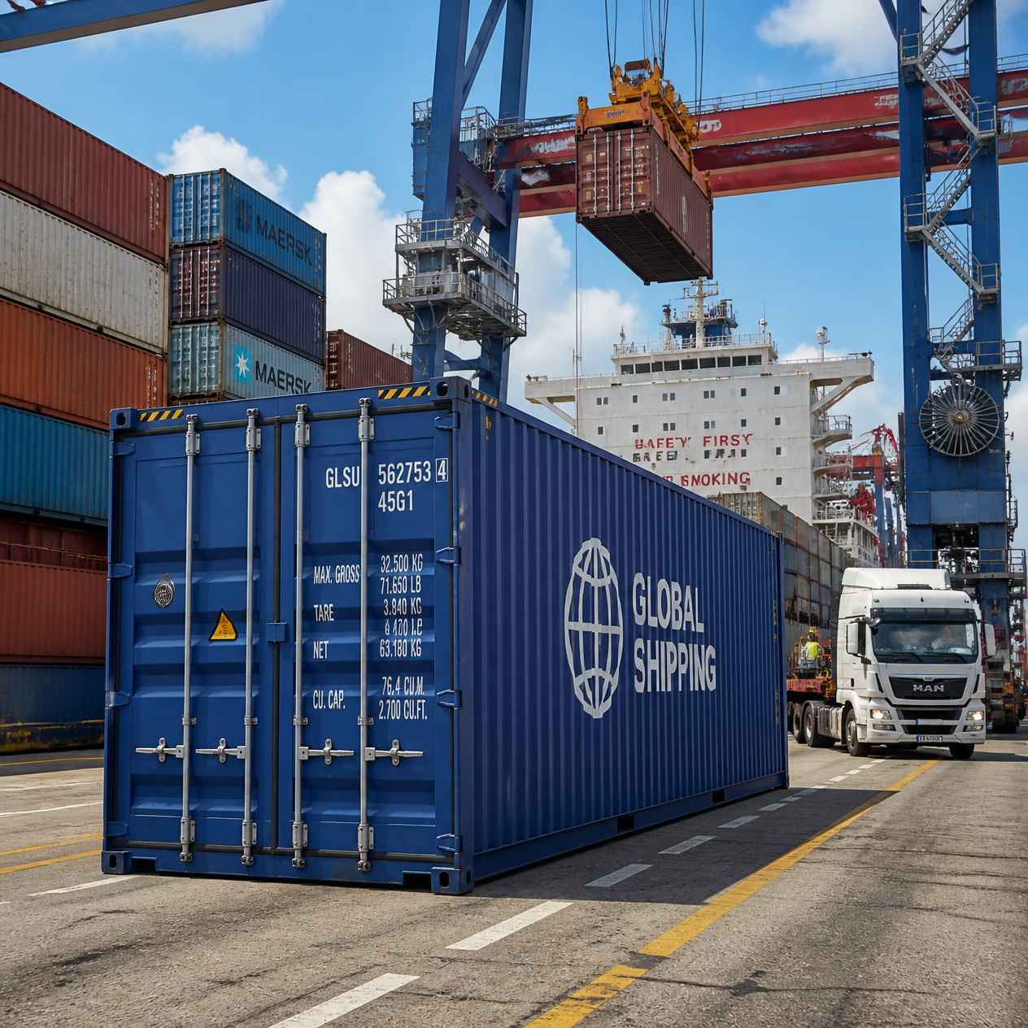
CONCLUSION & KEY TAKEAWAYS
  Developed an interactive Power BI report to analyse logistics operations and fleet performance.
  Integrated multiple operational datasets using data cleaning, modelling and DAX.
  Analysed revenue, route performance, customer contributions, delivery reliability and operating costs.
  Identified improvement opportunities in delivery performance and operational cost management.
  Applied Power BI visualisation and interactive features to support data-driven analysis.

Slide 11
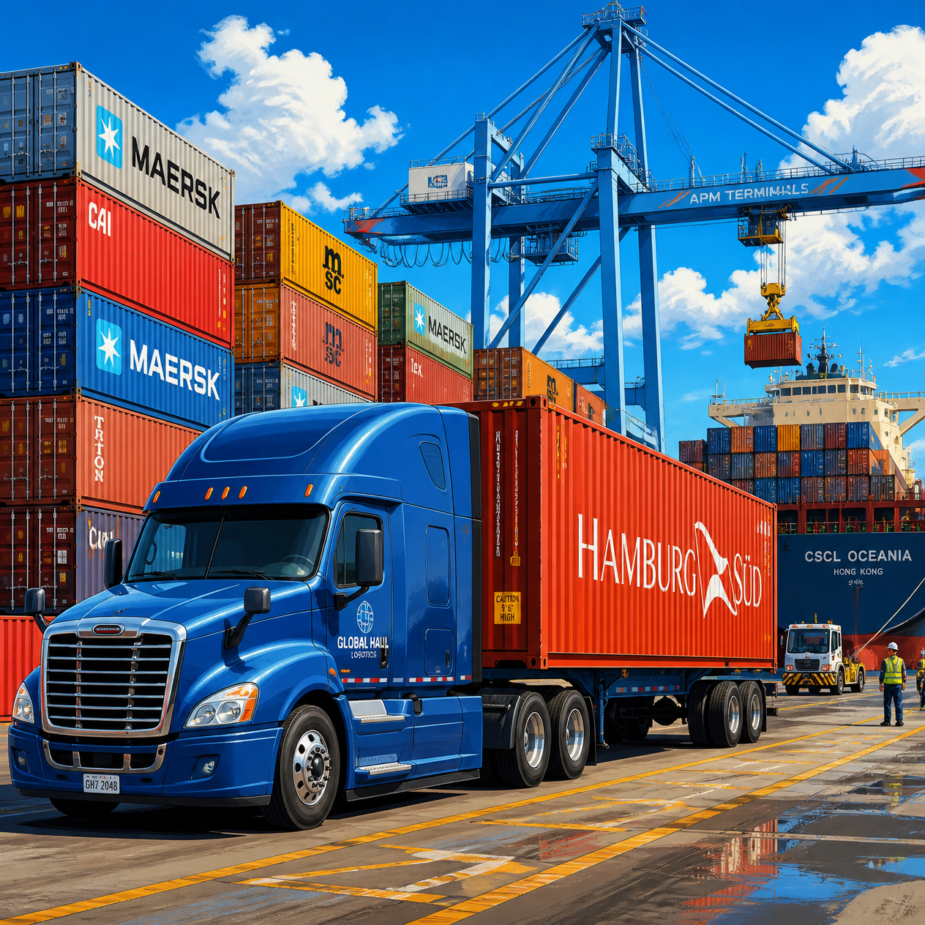
Thankyou

